Slide 1
Day 2 – Microservices Training
Amar Durga Tatyasaheb Patil Nikhil Damle
November – December, 2021

Slide 2
Microservices Patterns
Domain Driven Design
Monolith to Microservices Migration Strategies
Microservice Architecture Decisions
Introduction to Spring Boot, Concepts and Features
Demo / Hands-on on Spring Boot

Slide 3
Domain Driven Design
What is the Domain?
- The common dictionary definition of domain is: “A sphere of knowledge or activity.”
- Drilling down a bit from that, domain in the realm of software engineering commonly refers to the subject area on which the application is intended to apply.
- In other words, during application development, the domain is the “sphere of knowledge and activity around which the application logic revolves.” - Another common term used during software development is the domain layer or domain logic, which may be better known to many developers as the business logic. - The business logic of an application refers to the higher-level rules for how business objects interact with one another to create and modify modelled data.

Slide 4
Domain Driven Design
What is Domain-Driven Design?
Initially introduced and made popular by programmer Eric Evans in his 2004 book, Domain-Driven Design:
Tackling Complexity in the Heart of Software, domain-driven design is the expansion upon and application of the domain concept, as it applies to the development of software. It aims to ease the creation of complex applications by connecting the related pieces of the software into an ever-evolving model.
DDD focuses on three core principles:
Focus on the core domain and domain logic.
Base complex designs on models of the domain.
Constantly collaborate with domain experts, in order to improve the application model and resolve any emerging domain-related issues.

Slide 5
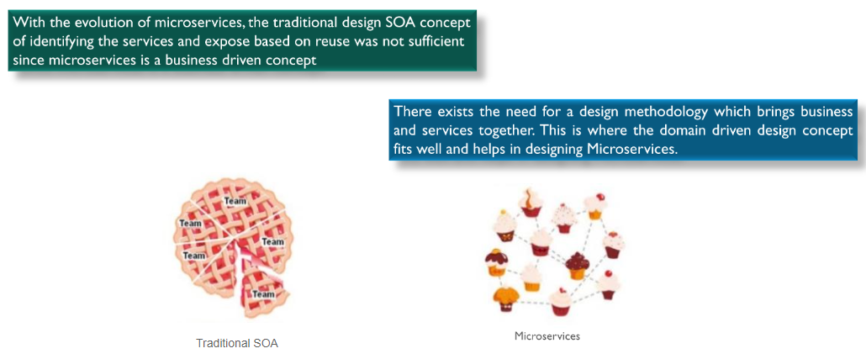
Domain Driven Design
Why is Domain-Driven Design?

Slide 6
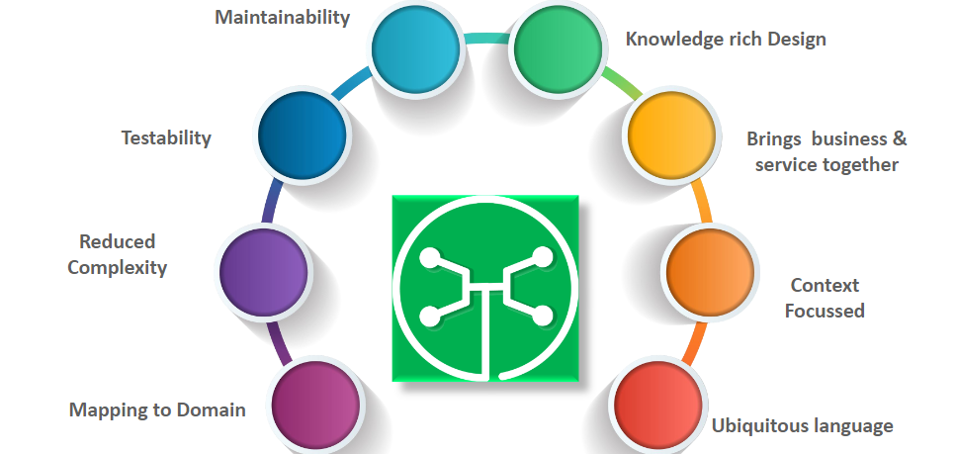
Domain Driven Design
Why is Domain-Driven Design?

Slide 7
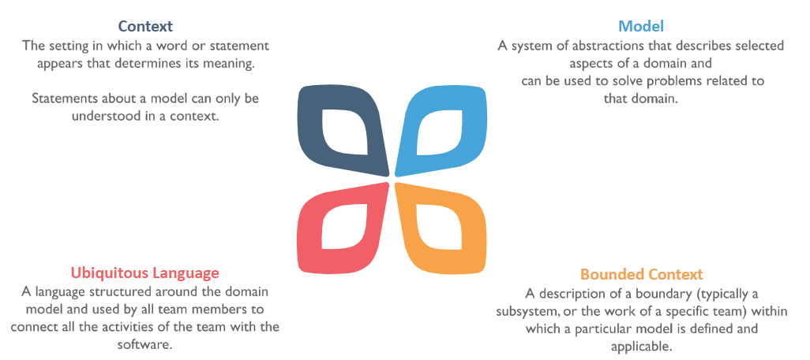
Domain Driven Design
Domain-Driven Concepts

Slide 8
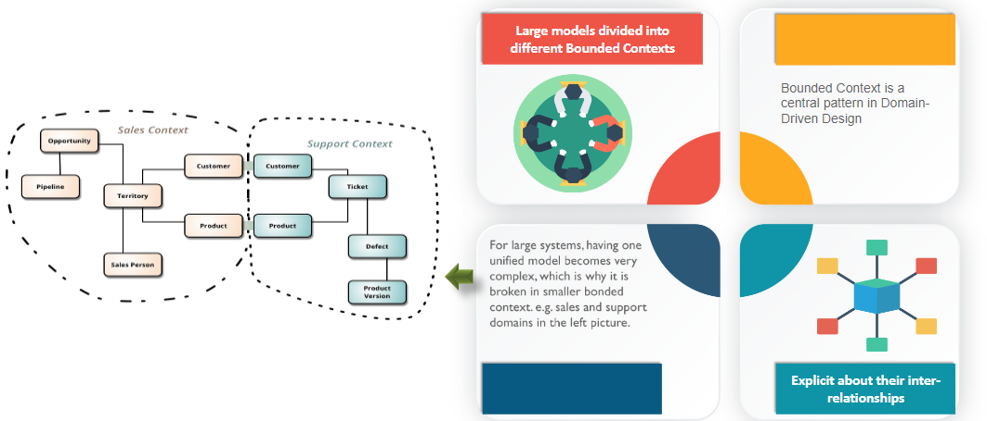
Domain Driven Design
What is bounded context?

Slide 9
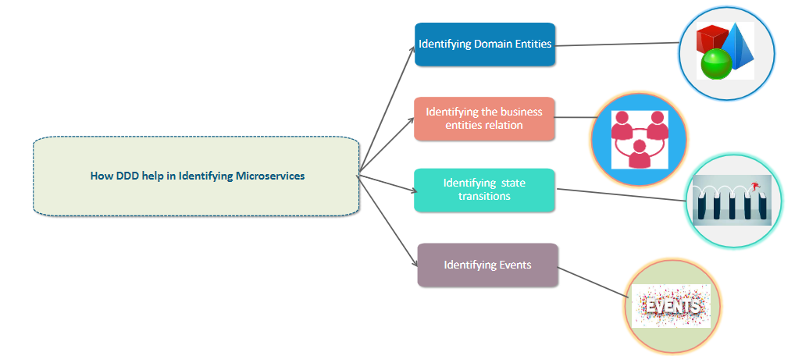
Domain Driven Design
How DDD help in Identifying Microservices?

Slide 10
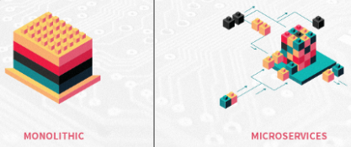
Monolith to Microservices Migration Strategies
By this time everyone know, Microservices are a new norm for the enterprise development and many newly built applications are inherently adopting MS core principles. However many enterprise organizations are seriously thinking/working to migrate their existing monolithic applications to microservices.
However this is where most interesting challenges lies, primarily because these monolithic applications are generally mission critical for the continued success of business. Hence migration must be as smooth as possible and we need to put right strategy to reap good benefits.

Slide 11
Table of Content
Standard Constraints
Strategies to Migrate
Parallel full redesign
Standard Microservices
Self Contained Systems
Migration best practices
Standard Constraints
Production application must continue to work smooth and end user should not feel any unwanted change in experience while migrating
Migration should not hinder team in adding more functionality to the existing system
During migration also, production support and devops team should look at one source of truth rather than multiple

Slide 12
Strategies to Migrate
There are few high level strategies we can follow while migrating monolithic applications. The recommended approach is to use the Strangler application pattern and incrementally migrate function from the monolith into services.
Approach will vary based on project conditions and as a architect you should take a call on right approach based on multiple constraints in project.
1. Parallel full redesign
Do not touch monolithic application, but start building a parallel application with MS architecture principles. This like a building a new application which exhibits same functional behaviour but with microservices.
Pros:
Existing monolithic application won’t be disturbed, hence user will not experience any challenges related to migration
Will have lesser constraints for developers, hence it is easy to architect, design and code
Cons:
Leads to typical waterfall model. Don’t know the outcome of the effort until last leg i.e. till all the time and money are spent.

Slide 13
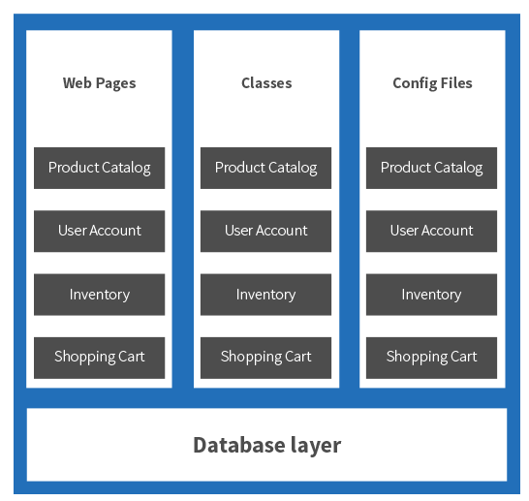
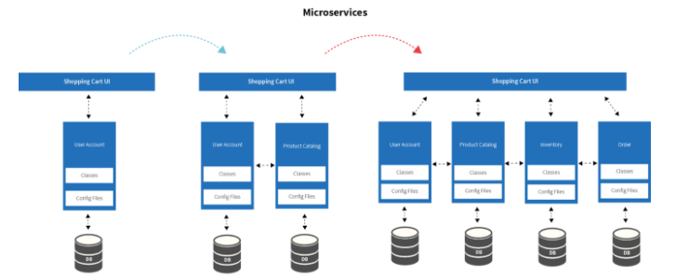

Slide 14
2. Standard Microservices
Identify the independent modules in existing monolithic application and convert the backend functionality into Microservices and replace all the direct calls for this module across the application( including UI and Backend) with microservice calls. Keep doing the same step for all the modules in iterative form till complete application is broken into microservices. Sometimes you may need to divide a microservice module into multiple microservices in order bring in better granularity.
Pros:
Part of application will be migrated in each iteration, hence customer can see iterative progress on migration
Lessons learned in previous iteration can be adopted in next iteration, hence team will continue to grow strong with each iteration
Cons:
Changes in existing monolithic application will be high in order to integrate with newly created microservices module.
UI code will continue to be monolithic

Slide 15
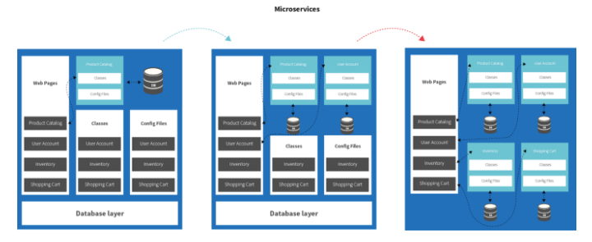

Slide 16
3. Self Contained Systems
Identify the module which can work independently, then convert the backend into microservices and rebuild UI for that specific portion as independent UI module. Then replace old functionality with both UI and Microservices(Self Contained Systems). Self Contained Systems contains both backend and UI and all the time they are expected to work as complete and independent module. These modules are loosely integrated with main monolithic application i.e. many times with simple URL reference. Iterate the above process till the complete monolithic application is migrated to Self Contained Systems. After completion of migration, application will be loosely coupled group of UI components and set of microservices.
Pros:
Part of application will be migrated in each iteration, hence customer can see iterative progress on migration
Lessons learned in previous iteration can be adopted in next iteration, hence team will continue to grow strong with each iteration
UI also gets migrated to independent modules hence development will become faster and quicker for each module
User will see visible changes for each iteration in the application
Cons:
As more modules move to Self Contained Systems, communication among these modules will become much more complex especially at UI level
Not all famous UI frameworks we have now has very good support for versioning management for modules.

Slide 17
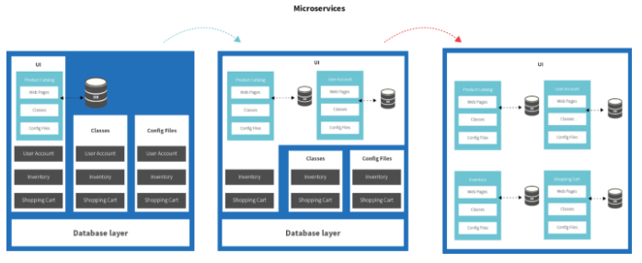

Slide 18
Migration Best Practices
Best practices vary from one strategy to another strategy. However there a generic practices that we must adopt irrespective of strategy we choose. We will cover those generic practices here.
Identify the most independent module and migrate that first.
Never allow the migrated microservices module code to continue in monolithic application.
Build or Choose a framework which takes care of cross cutting concerns and developers will focus only on business functionality.
Do not hesitate to break the existing microservice to further smaller microservices.

Slide 19
Architecture and Design Decisions
Business Decisions
Architecture Decisions

Slide 20
Business Decisions
Before implementing a microservices-based application development strategy, you must first evaluate your business readiness and make the necessary business-level decisions to ensure the long-term success of your project. Compared to the traditional monolithic approach, a microservices strategy involves several different forms of business investment, including financial investments, an investment in the culture of your workplace, and an investment in new development and operations.
Financial Investments
Financially, creating a microservices environment will require costs related to the up front architecture and design effort that is required to build many discrete, loosely coupled, asynchronous services that are resilient, scalable, and easy to monitor and manage. Additionally, you must invest in unit testing, integration testing, and full deployment automation of these microservices. These investments should result in a lower overall total cost of ownership for those applications that need the qualities that microservices satisfy. There must be explicit business awareness of these costs and benefits, and a corresponding commitment to make the required financial investments.

Slide 21
Business Decisions
Cultural Investments
Adopting microservices entails an investment—or commitment—to a new culture of employee flexibility and empowerment. Traditional employee roles will not suffice in the new culture. To succeed, you need a culture that gives development teams the ability to make decisions that were previously not in their control. For example, you will need to let the development teams – select the tools and technologies used by developers who are coding microservices, enable teams to customize how they do QA, and empower development teams to set their own deployment cycles.
DevOps Investments
Investment in new development and operations (DevOps) disciplines is also required. These disciplines are largely centred on continuous delivery and automation, which allows for quick iterations, low-risk experimentation, continuous feedback, and continuous improvement. For many companies, institutionalizing these disciplines requires a significant investment in employee training as well as acquiring skills from the marketplace.

Slide 22
Architecture and Design Decisions
As with any engineering activity, it is always beneficial to invest time up front to ensure you are using the most appropriate architectural approaches and making the necessary application design-specific decisions to help you achieve your business objectives.
Microservices, by their nature, introduce new approaches and considerations to architecture and design. Security, for instance, is increasing in importance, and must be designed up front, not as an afterthought. Likewise, the selection of the most appropriate application design patterns for the type of microservice function will help you achieve a balance between agility, operability, and the long-term maintainability and evolution of the application.
The following are some ideas for putting a microservices-based application together:

Slide 23
Architecture Decision
Single Page Application (SPA) - With the introduction of more powerful browsers, proliferation of faster networks, and robust client-side languages, many web interfaces shifted from distributed multi-page applications to single-page applications. A single-page application (SPA) is a web-based interface that provides the user with a single entry point to the application and never reloads the page or navigates away from that initial experience. Built using a combination of HTML, CSS, and JavaScript, these applications respond to user input through dynamic service calls to backing REST-based services that update portions of the screen instead of redirecting to an entirely new page. This application architecture often simplifies the front-end experience with the tradeoff of more responsibility on the backing services.

Slide 24
Architecture Decision
Backend for Frontend – With the wide-spread adoption of single-page applications and REST-based APIs, there was soon a negative impact across user experiences through different channels. Requiring many backing services to populate an SPA would now delegate that responsibility to the browser to manage the many asynchronous REST-based services – often leading to very poor experiences across devices.
The common resolution to this issue was the implementation of a backend aggregator service that would then reduce the overall number of calls from the browser and in turn handle the bulk of the external backing service communication, returning a more easily managed single request to the browser. This evolved to be known as the Backend for Frontend pattern. The same team builds both the user experience and the BFF, often in the same language, leading to a both an increase in overall application performance and application delivery.

Slide 25
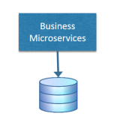
Architecture Decision
Business Microservice – a business microservice performs one comprehensive business function. Deciding to implement each business entity as a microservice is not the end of your design problems, however. You must also think about how you would implement the microservice and how that microservice relates to the other services in your overall business application.

Slide 26
Architecture Decision
Enforce strong contracts A microservice must provide a versioned, well-defined contract to its clients, which are other microservices. Each service must not break these versioned contracts until it's known that no other microservice relies on a particular, versioned contract.
Avoid chatty interfaces Chatty interfaces are interfaces that require you to perform multiple calls to accomplish a task. In a distributed system, this can have detrimental consequences to your service performance and availability.
Message serialization There are many important factors to consider for the serialization format: Who are the users, how much data is being transferred in each request, can the data be compressed? JSON is currently the popular format for microservices APIs, which can be parsed directly into an object graph, but JSON is not a compact format. Performance requirements may lead an API designer to consider other formats.
Blocking vs. non-blocking APIs One of the most important aspects of API design is whether to use blocking or non-blocking calls. Non-blocking APIs scale better, but are more complicated to design and use. Blocking APIs can have shortcomings addressed by some of the resilience patterns described later in this document.

Slide 27
Introduction to Spring Boot
Spring Boot makes it easy to create stand-alone, production-grade Spring based Applications that you can "just run".
We take an opinionated view of the Spring platform and third-party libraries so you can get started with minimum fuss. Most Spring Boot applications need minimal Spring configuration.
Features of Spring Boot
Create stand-alone Spring applications
Embed Tomcat, Jetty or Undertow directly (no need to deploy WAR files)
Provide opinionated 'starter' dependencies to simplify your build configuration
Automatically configure Spring and 3rd party libraries whenever possible
Provide production-ready features such as metrics, health checks, and externalized configuration
Absolutely no code generation and no requirement for XML configuration.

Slide 28
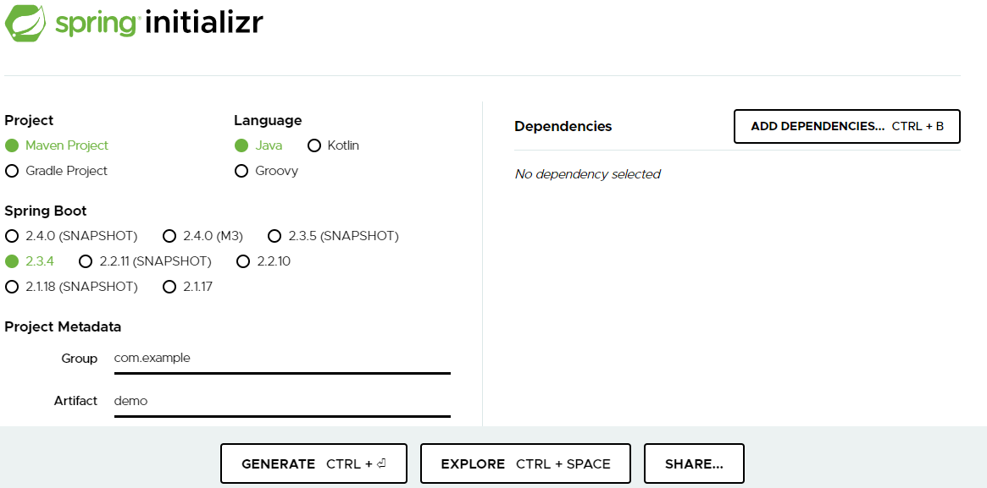
https://start.spring.io/ -- A good starting point

Slide 29
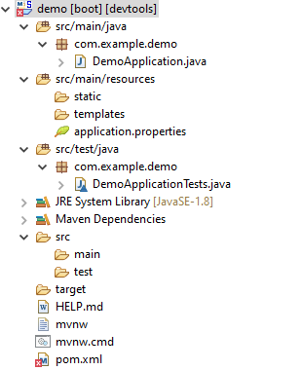
Folder Structure to be followed

Slide 30
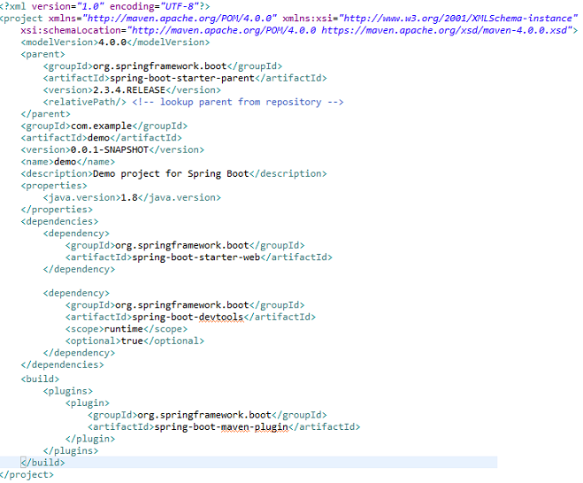
Understanding of pom.xml

Slide 31
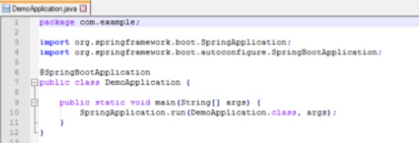
First Java Program for Spring boot

Slide 32
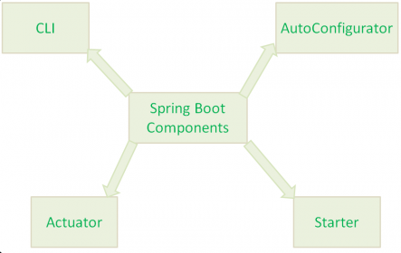
Spring Boot Concepts
Spring Boot Framework has mainly four major features or components:
Spring Boot Starters
Spring Boot AutoConfigurator
Spring Boot CLI
Spring Boot Actuator
NOTE: In addition to these four major components, there are two more Spring Boot components:
Spring Initializer
Spring Boot IDEs

Slide 33
Spring Boot Starters
Spring Boot Starters is one of the major key features or components of Spring Boot Framework. The main responsibility of Spring Boot Starter is to combine a group of common or related dependencies into single dependencies. We will explore this statement in detail with one example.
For instance, we would like to develop a Spring WebApplication with Tomcat WebServer. Then we need to add the following minimal jar dependencies in your Maven’s pom.xml file or Gradle’s build.gradle file
Spring core Jar file(spring-core-xx.jar)
Spring Web Jar file(spring-web-xx.jar)
Spring Web MVC Jar file(spring-webmvc-xx.jar)
Servlet Jar file(servlet-xx.jar)
If we want to add some database stuff, then we need to add database related jars like Spring JDBC jar file, Spring ORM jar files,Spring Transaction Jar file etc.
Spring JDBC Jar file(spring-jdbc-xx.jar)
Spring ORM Jar file(spring-orm-xx.jar)
Spring Transaction Jar file(spring-transaction-xx.jar)

Slide 34
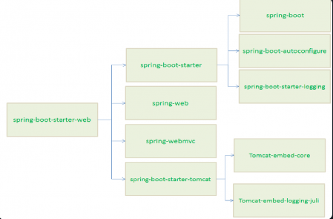
We need to define lot of dependencies in our build files. It is very tedious and cumbersome tasks for a Developer. And also it increases our build file size.
What is the solution to avoid this much dependencies definitions in our build files? The solution is Spring Boot Starter component.
Spring Boot Starter component combines all related jars into single jar file so that we can add only jar file dependency to our build files. Instead of adding above 4 jars files to our build file, we need to add one and only one jar file: “spring-boot-starter-web” jar file.
When we add “spring-boot-starter-web” jar file dependency to our build file, then Spring Boot Framework will automatically download all required jars and add to our project classpath.

Slide 35
In the same way, “spring-boot-starter-logging” jar file loads all it’s dependency jars like “jcl-over-slf4j, jul-to-slf4j,log4j-over-slf4j, logback-classic” to our project classpath.
Major Advantages of Spring Boot Starter
Spring Boot Starter reduces defining many dependencies simplify project build dependencies.
Spring Boot Starter simplifies project build dependencies.
Spring Boot AutoConfigurator
Another important key component of Spring Boot Framework is Spring Boot AutoConfigurator. Most of the Spring IO Platform (Spring Framework) Critics opinion is that “To develop a Spring-based application requires lot of configuration (Either XML Configuration of Annotation Configuration). Then how to solve this problem.
The solution to this problem is Spring Boot AutoConfigurator. The main responsibility of Spring Boot AutoConfigurator is to reduce the Spring Configuration. If we develop Spring applications in Spring Boot, then We don’t need to define single XML configuration and almost no or minimal Annotation configuration. Spring Boot AutoConfigurator component will take care of providing those information.

Slide 36
For instance, if we want to declare a Spring MVC application using Spring IO Platform, then we need to define lot of XML Configuration like views, view resolvers etc. But if we use Spring Boot Framework, then we dont need to define those XML Configuration. Spring Boot AutoConfigurator will take of this.
If we use “spring-boot-starter-web” jar file in our project build file, then Spring Boot AutoConfigurator will resolve views, view resolvers etc. automatically.
And also Spring Boot reduces defining of Annotation configuration. If we use @SpringBootApplication annotation at class level, then Spring Boot AutoConfigurator will automatically add all required annotations to Java Class ByteCode.
If we go through Spring Boot Documentation, we can find the following definition for @SpringBootApplication.
@Target(value=TYPE)
@Retention(value=RUNTIME)
@Documented
@Inherited
@Configuration
@EnableAutoConfiguration
@ComponentScan
public @interface SpringBootApplication

Slide 37
That is, @SpringBootApplication = @Configuration + @ComponentScan + @EnableAutoConfiration.
That’s it about Spring Boot AutoConfigurate component. We will discuss some more details with some Spring Boot examples in coming posts.
NOTE:-
In simple words, Spring Boot Starter reduces build’s dependencies and Spring Boot AutoConfigurator reduces the Spring Configuration.
As we discussed that Spring Boot Starter has a dependency on Spring Boot AutoConfigurator, Spring Boot Starter triggers Spring Boot AutoConfigurator automatically.

Slide 38
Spring Boot CLI
Spring Boot CLI(Command Line Interface) is a Spring Boot software to run and test Spring Boot applications from command prompt. When we run Spring Boot applications using CLI, then it internally uses Spring Boot Starter and Spring Boot AutoConfigurate components to resolve all dependencies and execute the application.
We can run even Spring Web Applications with simple Spring Boot CLI Commands.
Spring Boot CLI has introduced a new “spring” command to execute Groovy Scripts from command prompt.
Spring Command Example:
spring run HelloWorld.groovy
Here HelloWorld.groovy is a Groovy script FileName. Like Java source file names have *.java extension, Groovy script files have *.groovy extension. “spring” command executes HelloWorld.groovy and produces output.
Spring Boot CLI component requires many steps like CLI Installation, CLI Setup, Develop simple Spring Boot application and test it. So we are going to dedicate another post to discuss it in details with some Spring Boot Examples. Please refer my next post on Spring Boot CLI.

Slide 39
Spring Boot Actuator
Spring Boot Actuator components gives many features, but two major features are
Providing Management EndPoints to Spring Boot Applications.
Spring Boot Applications Metrics.
When we run our Spring Boot Web Application using CLI, Spring Boot Actuator automatically provides hostname as “localhost” and default port number as “8080”. We can access this application using “https://localhost:8080/” end point.
We actually use HTTP Request methods like GET and POST to represent Management EndPoints using Spring Boot Actuator.

